Slide 1

ICP Presentation Two
ICP Group 9
Team Members:
Gopi Nelluri
Srikanth Gude
GitHub Links:
https://github.com/gudesrikanth/webcourse/tree/main/MobilePart
https://github.com/gudesrikanth/webcourse/tree/main/Webpart/ICP11
https://github.com/gudesrikanth/webcourse/tree/main/Webpart/ICP10
https://github.com/gudesrikanth/webcourse/tree/main/Webpart/ICP9
https://github.com/gudesrikanth/webcourse/tree/main/Webpart/ICP8

Slide 2

Introduction
We used following technologies to complete the tasks - Java, Android Studio and XML.
Android Studio is an open-source development platform that allows us to create applications for Android-based mobile devices, tablets, and televisions.
We have chosen Java as the programming language for the development of the mobile application. Whenever a user performs an action, the functionality of the action is written in Java code.
For the layout of the app, we used the XML format, which is generally the default format used by Android studios for the design layout of apps.

Slide 3
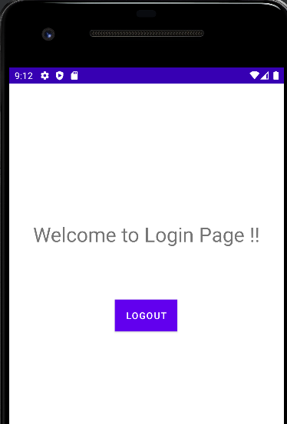
ICP – 8(Login and Logout in Android App)
In this Task, we have created a Login and Logout page in Android APP.
When the user was able to successfully submitted their username and password, they were redirected to a welcome page, where they have accessed to the logout option.
When the user was entered an invalid username or password, app has been not redirected the user to the welcome page and displayed respected error message.
When the user was clicked on the logout button, the app has allowed the user to logout and displayed the login page.

Slide 4
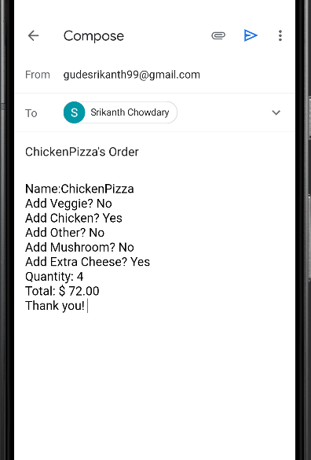
ICP – 9(Pizza ordering app)
In this Task, we have used Android Studio to create a Food Ordering App for Pizza.
The Order Page displayed a text area where we can input your name, type of pizza, and topping section where you can select from the checkboxes, and a quantity part where you can enter the number of pizzas that you want to order (i.e., the number of pizzas that you want to order).
You have a choice between two Buttons. The first is named ORDER, while the second is named SUMMARY.
When the user was clicked on the logout button, the app has allowed the user to logout and displayed the login page.
When the user clicks on the ORDER button, it allows the user to send an email to the specified recipient, along with a description of the order and the order details.
When the user clicked on the SUMMARY button, a new page is displayed, which includes the Summary of the Pizza order, an image of the Pizza, and the GOTO ORDER button. By clicking GOTO ORDER button, the user is taken to the order's main page.

Slide 5
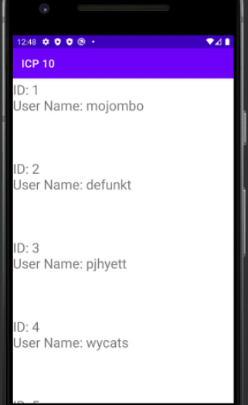
ICP – 10(Fetching User Details from GitHub using RESTful Services)
In this Task, we were asked to print the ID and Username of each GitHub user from the website https://api.github.com> using Android Studio, as well as any other information we learned.
When we have executed the information of GitHub users has been printed on the Android phone. When you scroll down the page, you'll see the information for all the GitHub users.

Slide 6
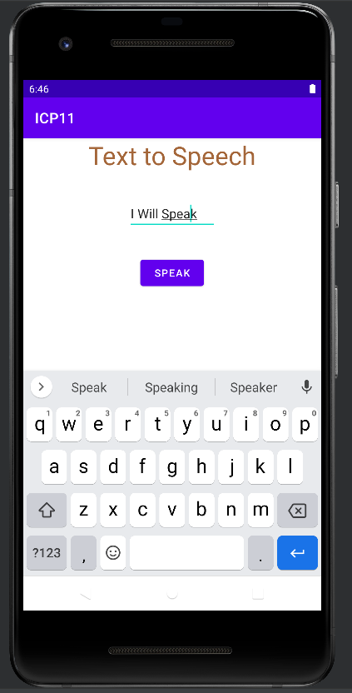
ICP – 11(Text to Speech Recognition)
In this Task, we have created an application named Text to Speech Recognition, which can speak what we have given as a text input.
Initially when the application is opened it asks to enter text to input text box.
When the user was clicked on speak button it will speak the text entered by user.

Slide 7

Conclusion
We used technologies like Java, Android Studio and XML to complete several tasks.
Firstly, we have designed and developed a mobile application for login page.
Later, we have developed a mobile application for Food Ordering App for Pizza.
Moreover, we have designed a mobile application to fetching user details from GitHub using RESTful services.
At Last, we have created an android application for Text to Speech Recognition.

